Slide 1
Momentum Contrast for Unsupervised Visual Representation Learning Kaiming He, Haoqi Fan, Yuxin Wu, Saining Xie, Ross Girshick Facebook AI Research(FAIR) 2019, CVPR

Slide 2
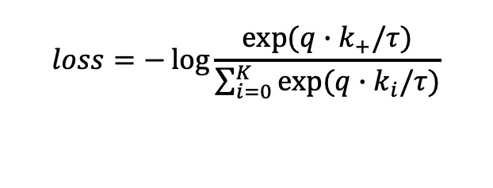


Background
Unsupervised Representation: contrastive loss.
Query: An encoder to perform dictionary look-up .
Dictionaries: An encoder(Siamese with query encoder) to perform keys.
$$loss=−\log{\frac{exp⁡(q∙k_{+}/τ)}{\sum_{i=0}^{K}{exp⁡(q∙k_{i}/τ)}}}$$
$$q=f_{q}(x^{q})$$
$$k=f_{k}(x^{k})$$

Slide 3
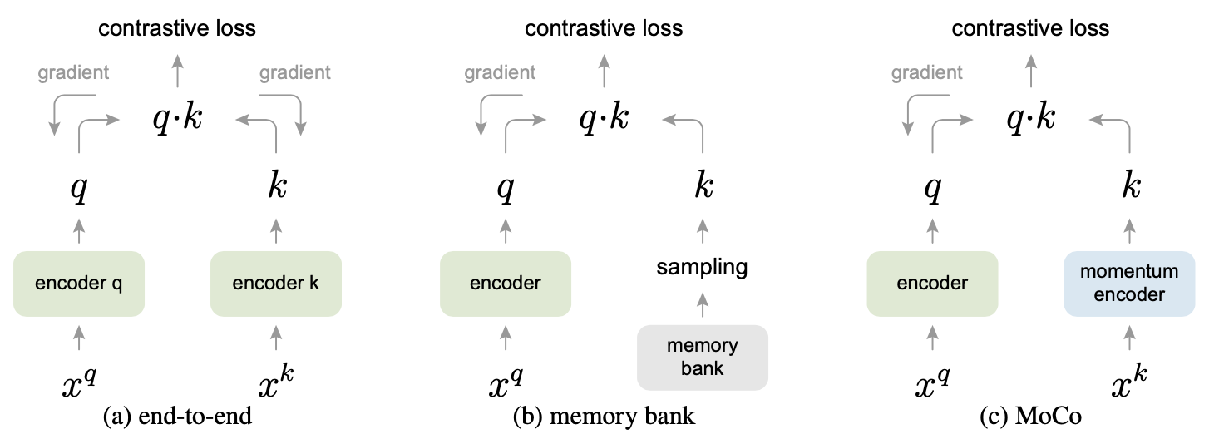
Related Work
End-to-end: size of dictionary coupled with batch size .
Memory bank: large but less consistent.
Moco: large & decoupled with batch size & consistent .

Slide 4
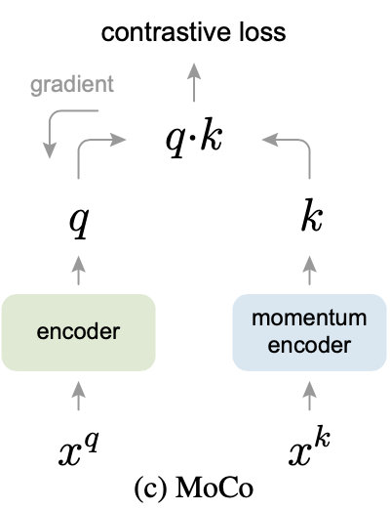
Moco
Dictionary as a queue: enqueue(currentBatch); dequeue(oldestBatch).
Momentum update: $θ_{k}=mθ_{k}+(1−m{)θ}_{q}$
Moco: large & decoupled with batch size & consistent .

Slide 5
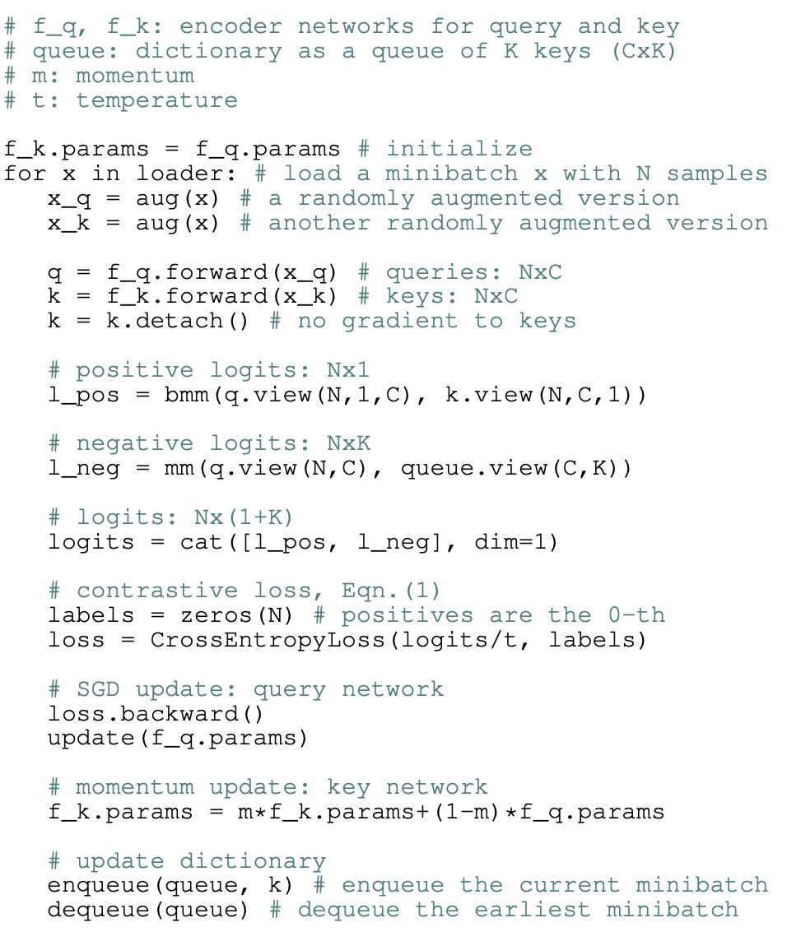
Moco(pseudo code)

Slide 6
Experiment-pretrain
ImageNet-1M (IN-1M)
Instagram-1B (IG-1B)
Training: SGD(decay=0.001,momentum=0.9), batchSize = 256&1024

Slide 7
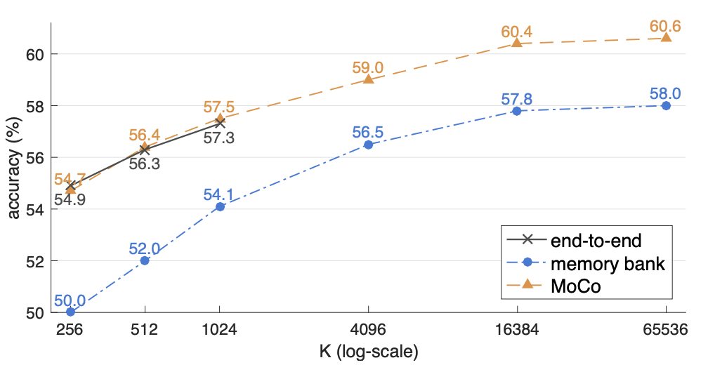
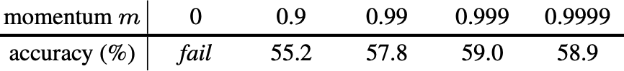
Experiment-Classification

Slide 8
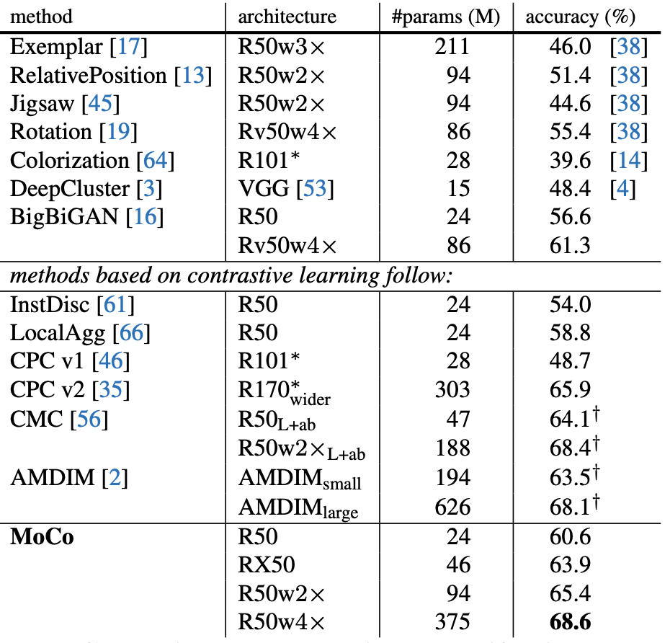
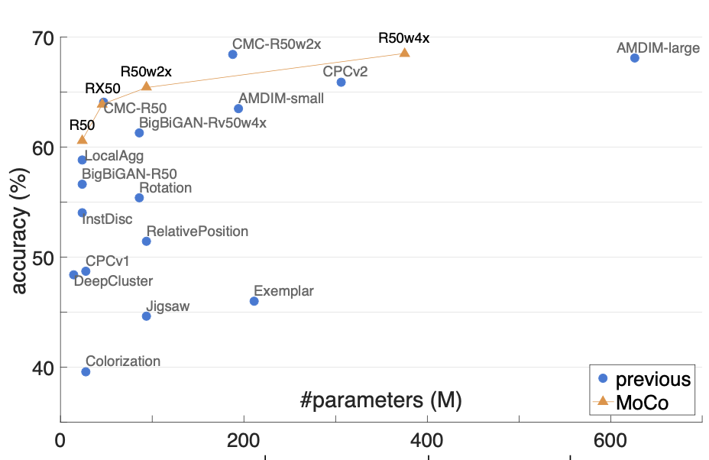
Experiment-Classification

Slide 9
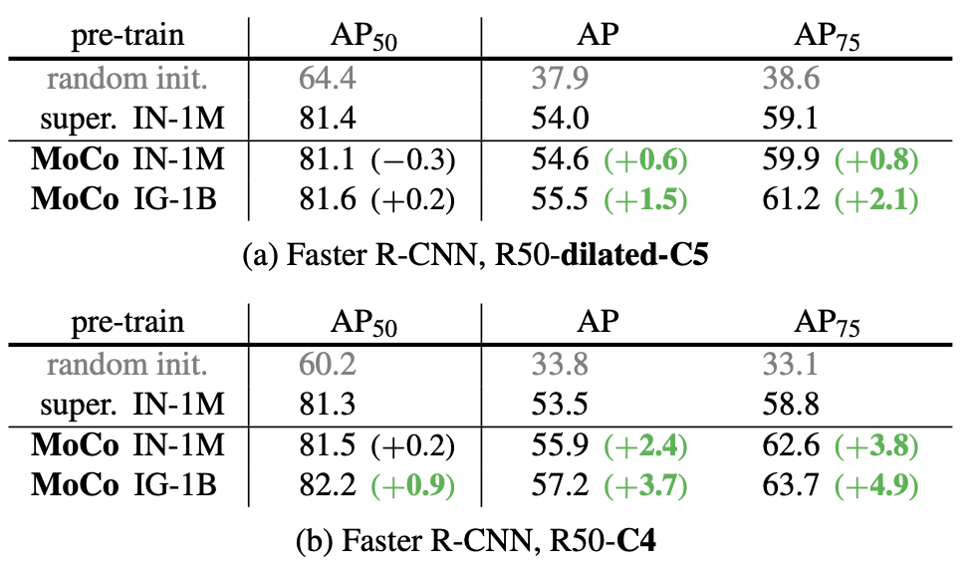
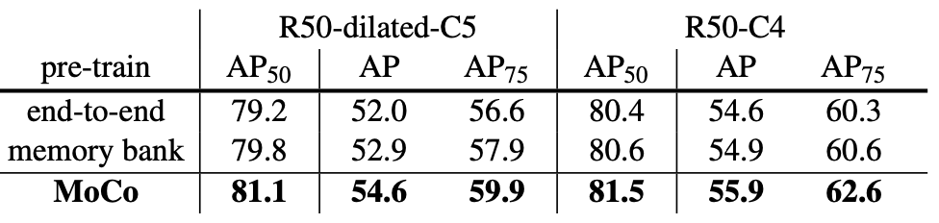
Experiment-Object Detection

Slide 10
Conclusion
Dictionary as queue.
Momentum update.

Slide 11
Improved Baselines with Momentum Contrastive Learning (MOCO V2) Kaiming He, Haoqi Fan, Yuxin Wu, Saining Xie, Ross Girshick Facebook AI Research(FAIR)

Slide 12
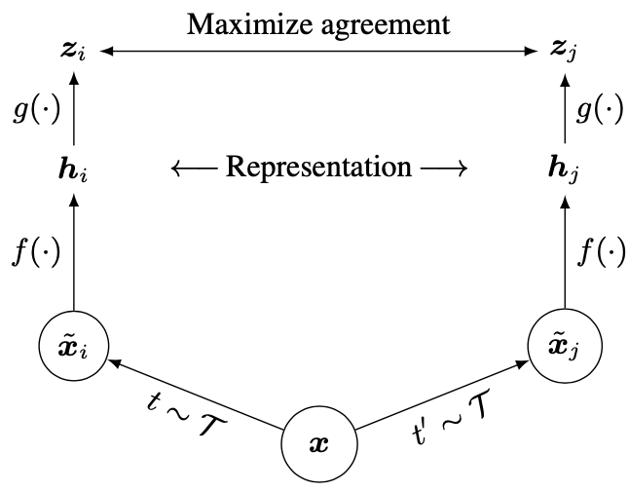
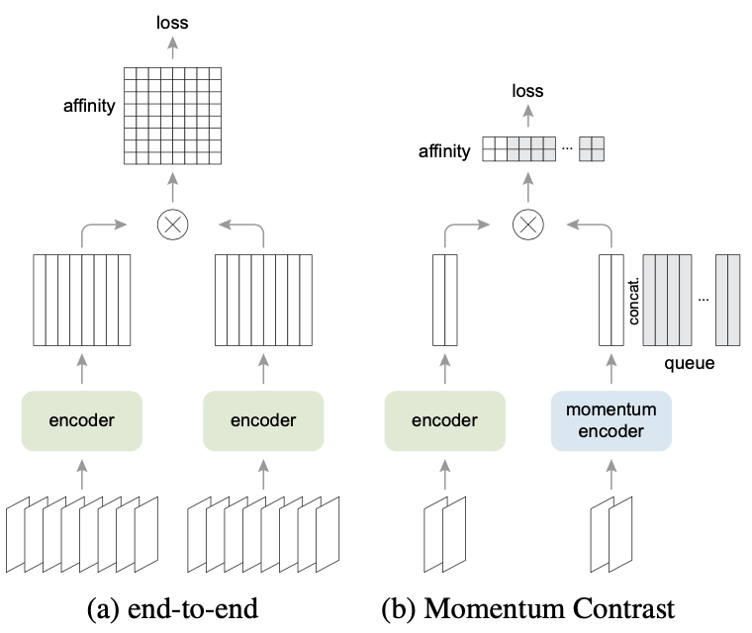
Improved
Projection head & Strong aug: comes from SimCLR.

Slide 13
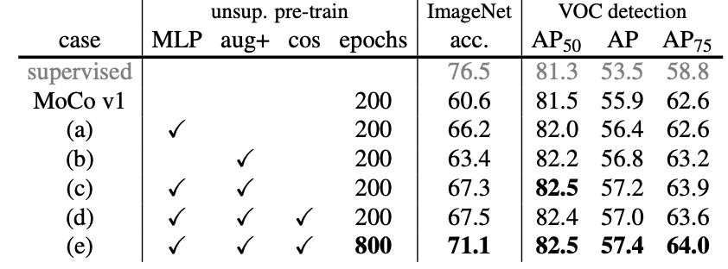
Experiment-Classification

Slide 14
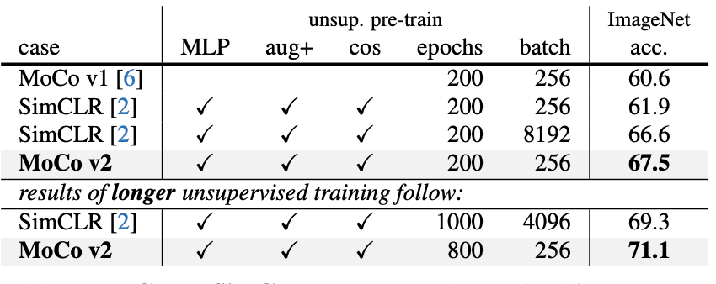
Experiment-Classification

Slide 15
Thank you (Q&A)
Notes:
RP Shortcomings：1.relative position has multi result. 2.CNN learn trivial features. 3. not whole picture.

